Slide 1
Hall sensor base model

Slide 2
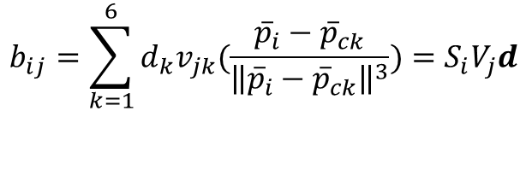
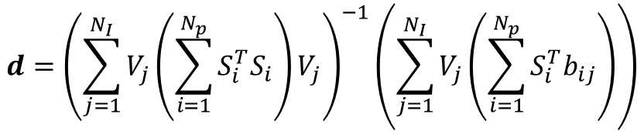

Hall sensor base model
Previous model
$$b_{ij}=\sum_{k=1}^{6}{d_{k}v_{jk}(\frac{{\overline{p}}_{i}−{\overline{p}}_{ck}}{{\left\|{\overline{p}}_{i}−{\overline{p}}_{ck}\right\|}^{3}})}=S_{i}V_{j}d$$
$V_{j}=diag[v_{j1}{ v}_{j2}$ $v_{j3} v_{j4} v_{j5} v_{j6} ] , d={[d_{1} d_{2 }d_{3 }d_{4 }d_{5 }d_{6 }]}^{T}$
$$ε_{ij}=b_{ij}−S_{i}V_{j}d$$
$$d={\left(\sum_{j=1}^{N_{I}}{V_{j}}\left(\sum_{i=1}^{N_{p}}{S_{i}^{T}S_{i}}\right)V_{j}\right)}^{−1}\left(\sum_{j=1}^{N_{I}}{V_{j}}\left(\sum_{i=1}^{N_{p}}{S_{i}^{T}b_{ij}}\right)\right)$$

Slide 3

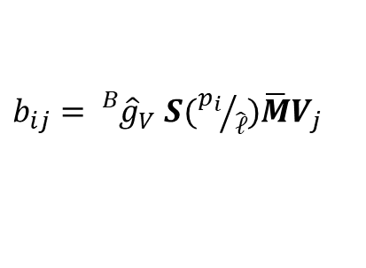
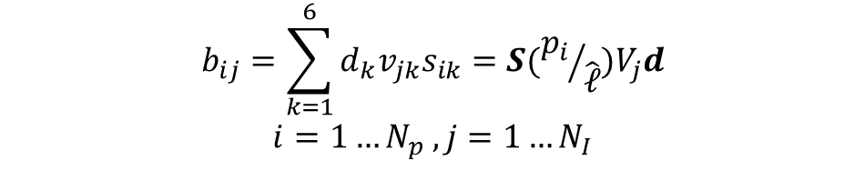
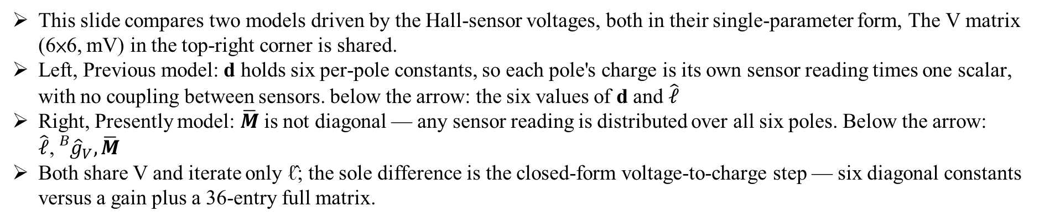

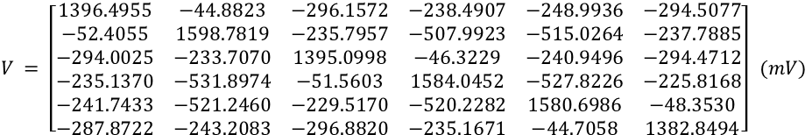
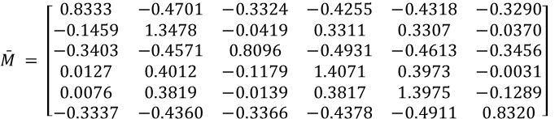

Hall sensor base model
$$V = \left[\begin{matrix}1396.4955 & −44.8823 & −296.1572 & −238.4907 & −248.9936 & −294.5077 \\ −52.4055 & 1598.7819 & −235.7957 & −507.9923 & −515.0264 & −237.7885 \\ −294.0025 & −233.7070 & 1395.0998 & −46.3229 & −240.9496 & −294.4712 \\ −235.1370 & −531.8974 & −51.5603 & 1584.0452 & −527.8226 & −225.8168 \\ −241.7433 & −521.2460 & −229.5170 & −520.2282 & 1580.6986 & −48.3530 \\ −287.8722 & −243.2083 & −296.8820 & −235.1671 & −44.7058 & 1382.8494\end{matrix}\right] (mV)$$
This slide compares two models driven by the Hall-sensor voltages, both in their single-parameter form, The V matrix (6×6, mV) in the top-right corner is shared.
Left, Previous model: d holds six per-pole constants, so each pole's charge is its own sensor reading times one scalar, with no coupling between sensors. below the arrow: the six values of d and $\hat{ℓ}$
Right, Presently model: $\overline{M}$ is not diagonal — any sensor reading is distributed over all six poles. Below the arrow: $\hat{ℓ}$,${}_{}^{B}{{\hat{g}}_{V}},\overline{M}$
Both share V and iterate only ℓ̂; the sole difference is the closed-form voltage-to-charge step — six diagonal constants versus a gain plus a 36-entry full matrix.
Previous model:
Presently model:
$$b_{ij}=\sum_{k=1}^{6}{d_{k}v_{jk}s_{ik}=S({p_{i}}/{\hat{ℓ}})V_{j}d}$$
$$i=1…N_{p} , j=1…N_{I}$$
$b_{ij}={}_{}^{B}{{\hat{g}}_{V}}$ $S({p_{i}}/{\hat{ℓ}})\overline{M}V_{j}$
$$\hat{ℓ} = 870.6 μm$$
$${}_{}^{B}{{\hat{g}}_{V}} = 5.0826×{10}^{−3} mT/mV$$
$$d={\left[7.052 5.756 7.09 5.709 5.775 7.152\right]}^{T}×{10}^{−3}$$
$$\bar{M} = \left[\begin{matrix}0.8333 & −0.4701 & −0.3324 & −0.4255 & −0.4318 & −0.3290 \\ −0.1459 & 1.3478 & −0.0419 & 0.3311 & 0.3307 & −0.0370 \\ −0.3403 & −0.4571 & 0.8096 & −0.4931 & −0.4613 & −0.3456 \\ 0.0127 & 0.4012 & −0.1179 & 1.4071 & 0.3973 & −0.0031 \\ 0.0076 & 0.3819 & −0.0139 & 0.3817 & 1.3975 & −0.1289 \\ −0.3337 & −0.4360 & −0.3366 & −0.4378 & −0.4911 & 0.8320\end{matrix}\right]$$
$$\hat{ℓ} = 870.6 μm$$

Slide 4
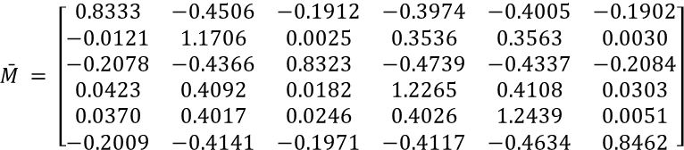
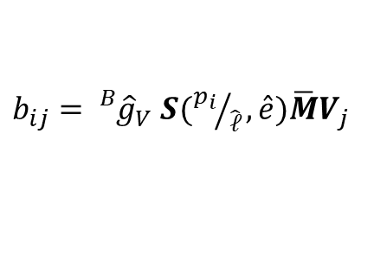

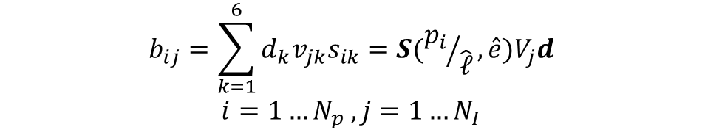

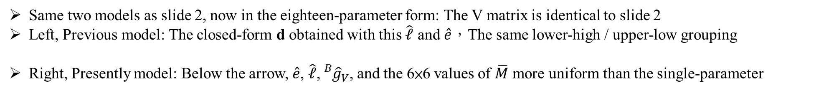
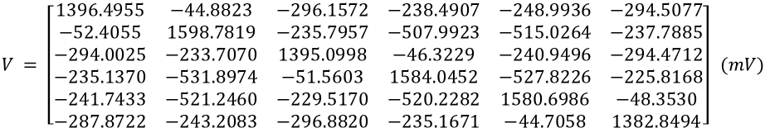

Hall sensor base model
$$V = \left[\begin{matrix}1396.4955 & −44.8823 & −296.1572 & −238.4907 & −248.9936 & −294.5077 \\ −52.4055 & 1598.7819 & −235.7957 & −507.9923 & −515.0264 & −237.7885 \\ −294.0025 & −233.7070 & 1395.0998 & −46.3229 & −240.9496 & −294.4712 \\ −235.1370 & −531.8974 & −51.5603 & 1584.0452 & −527.8226 & −225.8168 \\ −241.7433 & −521.2460 & −229.5170 & −520.2282 & 1580.6986 & −48.3530 \\ −287.8722 & −243.2083 & −296.8820 & −235.1671 & −44.7058 & 1382.8494\end{matrix}\right] (mV)$$
Same two models as slide 2, now in the eighteen-parameter form: The V matrix is identical to slide 2
Left, Previous model: The closed-form d obtained with this $\hat{ℓ}$ and $\hat{e}$，The same lower-high / upper-low grouping
Right, Presently model: Below the arrow, $\hat{e}$, $\hat{ℓ}$,${}_{}^{B}{{\hat{g}}_{V}}$, and the 6×6 values of $\overline{M}$ more uniform than the single-parameter
Previous model:
$$b_{ij}=\sum_{k=1}^{6}{d_{k}v_{jk}s_{ik}=S({p_{i}}/{\hat{ℓ}},\hat{e})V_{j}d}$$
$$i=1…N_{p} , j=1…N_{I}$$
Presently model:
$b_{ij}={}_{}^{B}{{\hat{g}}_{V}}$ $S({p_{i}}/{\hat{ℓ}},\hat{e})\overline{M}V_{j}$
$$\bar{M} = \left[\begin{matrix}0.8333 & −0.4506 & −0.1912 & −0.3974 & −0.4005 & −0.1902 \\ −0.0121 & 1.1706 & 0.0025 & 0.3536 & 0.3563 & 0.0030 \\ −0.2078 & −0.4366 & 0.8323 & −0.4739 & −0.4337 & −0.2084 \\ 0.0423 & 0.4092 & 0.0182 & 1.2265 & 0.4108 & 0.0303 \\ 0.0370 & 0.4017 & 0.0246 & 0.4026 & 1.2439 & 0.0051 \\ −0.2009 & −0.4141 & −0.1971 & −0.4117 & −0.4634 & 0.8462\end{matrix}\right]$$
$$d={\left[6.871 5.659 6.992 5.633 5.791 7.032\right]}^{T}×{10}^{−3}$$
$$\hat{e}= \left[\begin{matrix}0.0136 & 0.0213 & −0.1165 & 0.0005 & −0.0002 & −0.1175 \\ −0.1142 & 0.0019 & 0.0199 & 0.0187 & 0.0002 & −0.1162 \\ 0.1150 & −0.0025 & 0.1157 & −0.0012 & −0.0112 & −0.0178\end{matrix}\right]$$
$$\hat{e}= \left[\begin{matrix}0.0136 & 0.0213 & −0.1165 & 0.0005 & −0.0002 & −0.1175 \\ −0.1142 & 0.0019 & 0.0199 & 0.0187 & 0.0002 & −0.1162 \\ 0.1150 & −0.0025 & 0.1157 & −0.0012 & −0.0112 & −0.0178\end{matrix}\right]$$
$$\hat{ℓ} = 867.2 μm$$
$$\hat{ℓ} = 867.2 μm {}_{}^{B}{{\hat{g}}_{V}} = 5.9476×{10}^{−3} mT/mV$$

Slide 5
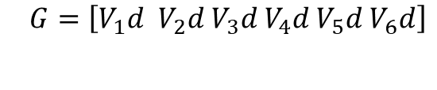
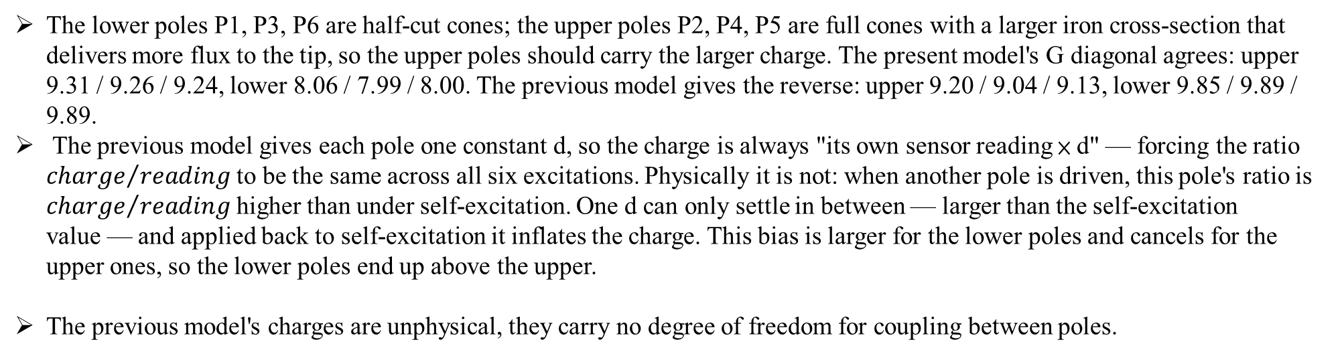
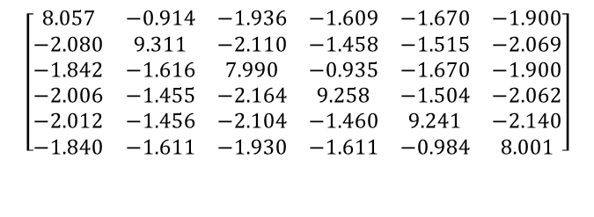
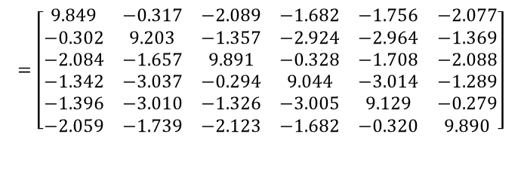

Hall sensor base model
The lower poles P1, P3, P6 are half-cut cones; the upper poles P2, P4, P5 are full cones with a larger iron cross-section that delivers more flux to the tip, so the upper poles should carry the larger charge. The present model's G diagonal agrees: upper 9.31 / 9.26 / 9.24, lower 8.06 / 7.99 / 8.00. The previous model gives the reverse: upper 9.20 / 9.04 / 9.13, lower 9.85 / 9.89 / 9.89.
The previous model gives each pole one constant d, so the charge is always "its own sensor reading × d" — forcing the ratio ${charge}/{reading}$to be the same across all six excitations. Physically it is not: when another pole is driven, this pole's ratio is ${charge}/{reading}$higher than under self-excitation. One d can only settle in between — larger than the self-excitation value — and applied back to self-excitation it inflates the charge. This bias is larger for the lower poles and cancels for the upper ones, so the lower poles end up above the upper.
The previous model's charges are unphysical, they carry no degree of freedom for coupling between poles.
Previous model:
Presently model:
$$G=\left[V_{1}d { V}_{2}d{ V}_{3}d{ V}_{4}d{ V}_{5}d{ V}_{6}d\right]$$
$$G={}_{}^{B}{{\hat{g}}_{V}}\overline{M}V$$
$$=\left[\begin{matrix}9.849 & −0.317 & −2.089 & −1.682 & −1.756 & −2.077 \\ −0.302 & 9.203 & −1.357 & −2.924 & −2.964 & −1.369 \\ −2.084 & −1.657 & 9.891 & −0.328 & −1.708 & −2.088 \\ −1.342 & −3.037 & −0.294 & 9.044 & −3.014 & −1.289 \\ −1.396 & −3.010 & −1.326 & −3.005 & 9.129 & −0.279 \\ −2.059 & −1.739 & −2.123 & −1.682 & −0.320 & 9.890\end{matrix}\right]$$
$$\left[\begin{matrix}8.057 & −0.914 & −1.936 & −1.609 & −1.670 & −1.900 \\ −2.080 & 9.311 & −2.110 & −1.458 & −1.515 & −2.069 \\ −1.842 & −1.616 & 7.990 & −0.935 & −1.670 & −1.900 \\ −2.006 & −1.455 & −2.164 & 9.258 & −1.504 & −2.062 \\ −2.012 & −1.456 & −2.104 & −1.460 & 9.241 & −2.140 \\ −1.840 & −1.611 & −1.930 & −1.611 & −0.984 & 8.001\end{matrix}\right]$$

Slide 6
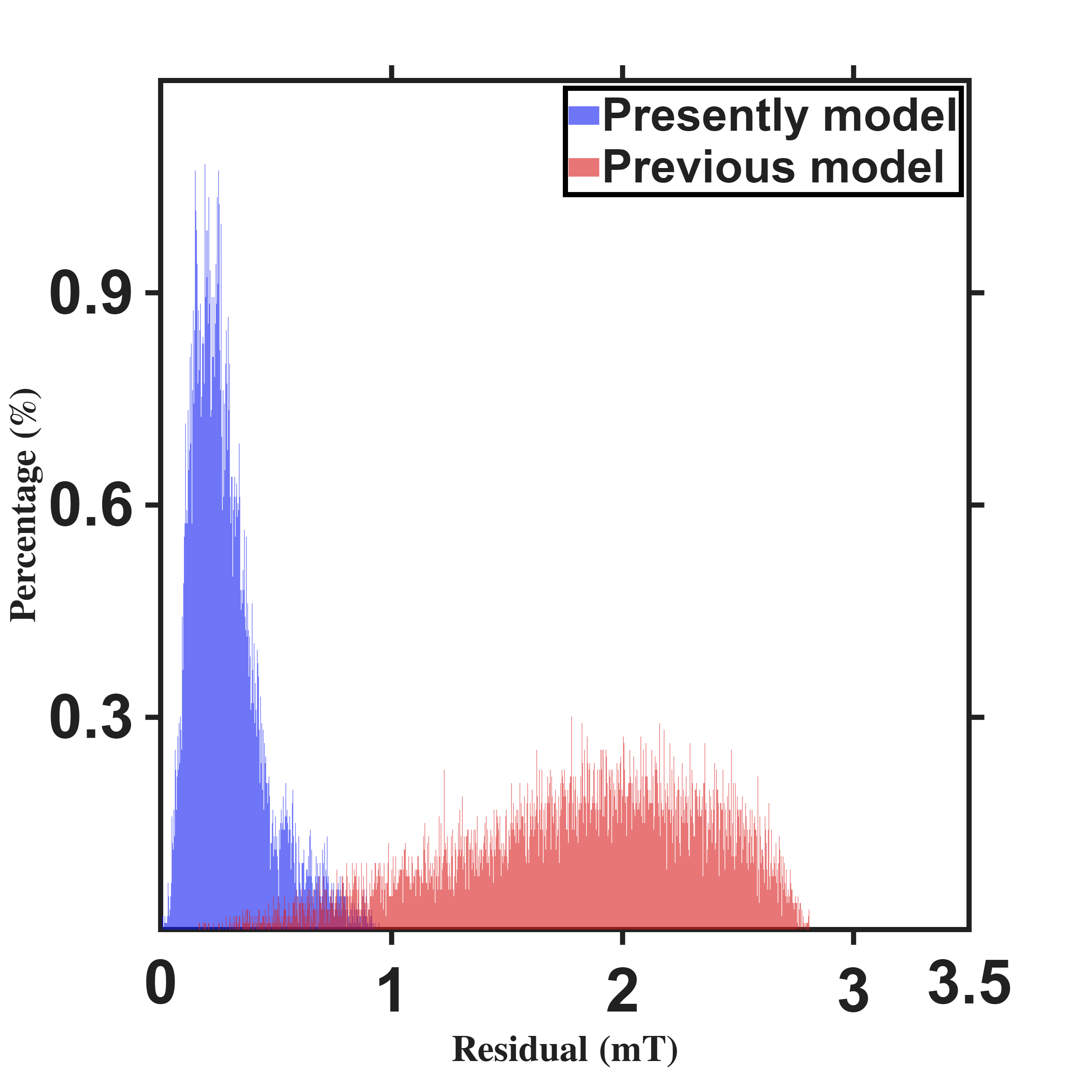
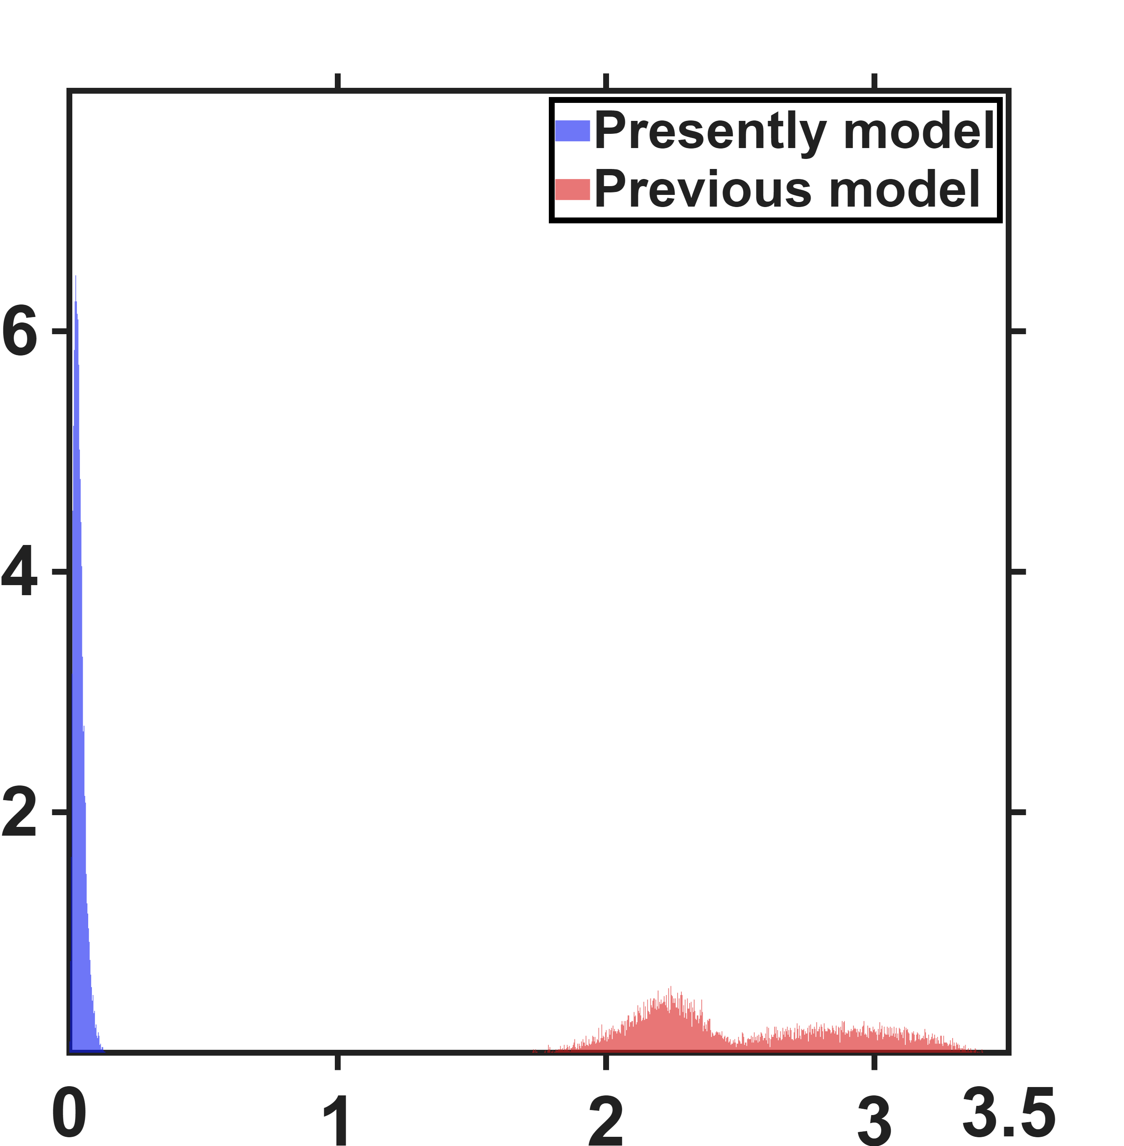
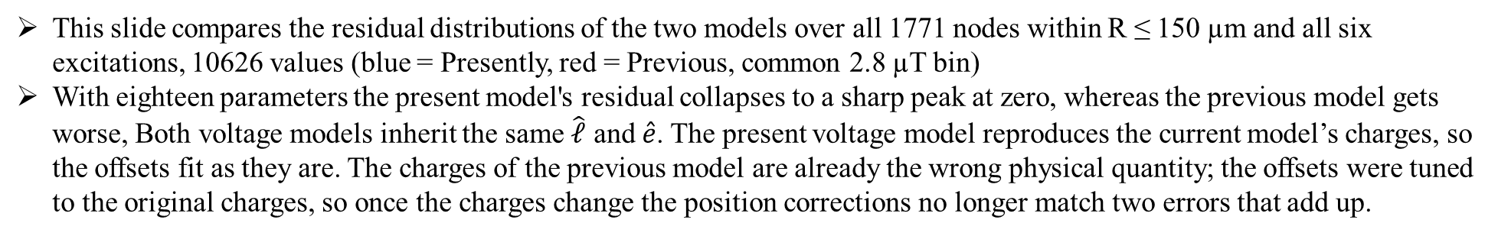




Hall sensor base model
This slide compares the residual distributions of the two models over all 1771 nodes within R ≤ 150 µm and all six excitations, 10626 values (blue = Presently, red = Previous, common 2.8 µT bin)
With eighteen parameters the present model's residual collapses to a sharp peak at zero, whereas the previous model gets worse, Both voltage models inherit the same $\hat{ℓ}$ and $\hat{e}$. The present voltage model reproduces the current model’s charges, so the offsets fit as they are. The charges of the previous model are already the wrong physical quantity; the offsets were tuned to the original charges, so once the charges change the position corrections no longer match two errors that add up.
Single parameters
Eighteen parameters
Percentage count $(\%)$
Percentage count $(\%)$
Modeling error $(mT)$
Modeling error $(mT)$
 | Previous | Presently
NMAE | 17.74% | 2.81%
 | Previous | Presently
NMAE | 24.57% | 0.35%

